Slide 2
Automated risk assessment of PyPi packages using unsupervised machine learning
EGH400-2 - Queensland University of Technology
Hari Markonda Patnaikuni n10789511
Notes:
Introduce myself, what unit the presentation is for

Slide 3
Project Motive and Aim
Motive: Increase the security of the software supply chain
Consensus of Literature Review: Most research papers used supervised machine learning to find risks with open-source packages
Research Question: Can unsupervised machine learning be used to automate risk assessment for PyPi packages at a large scale?
Aim: Based on these risks and anomaly scores calculate risk and reliability scores
Notes:
Discuss the project’s research question, motive (US Presidential Executive Order), and aim

Slide 4
The Data
Consists of 16000 packages metadata
Metadata consists of 6 different features
Features consist of Software Maturity, Freshness, Accessibility, Community Engagement, Vulnerability, and Popularity scores
Each Score is out of 1

Slide 5
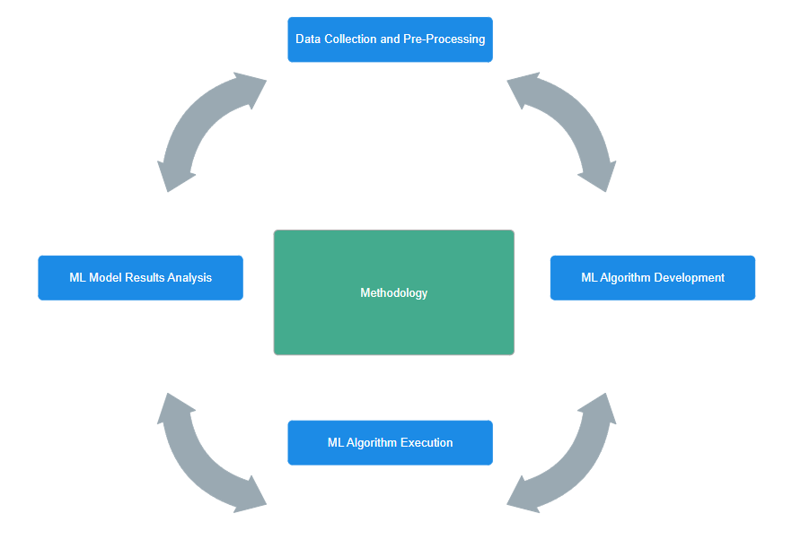
Methodology

Slide 6
Deliverables Achieved
Pre-processing of data
Input data to two unsupervised machine learning algorithms
Cluster data
Produce risk and reliability scores for 8000 packages
Notes:
Discuss the data used from the original dataset, pre-processing, types of ML algorithms used, and anomaly score generated

Slide 7
Types of Clustering tested
K-Means with 2 and 3 clusters
Gaussian Mixture with 3 clusters

Slide 8
K-Means Clustering 3 Clusters
Feature that influenced separation of clusters the most was Vulnerability Score
Community Engagement Score influenced separation of clusters to a lesser extent

Slide 9
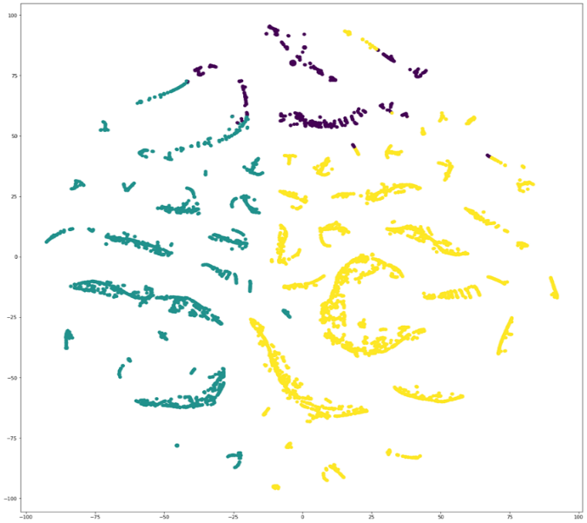
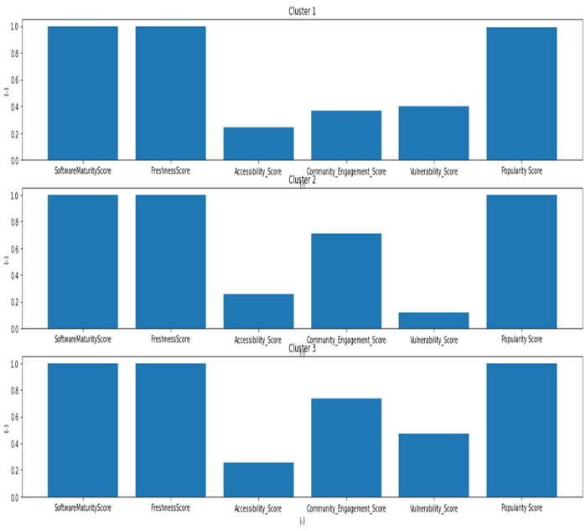
K-Means Clustering Graph
Figure 1: K-Means Clustering graph with 3 clusters, 6 features and random state of 59
Figure 2: K-Means Clustering Histograms

Slide 10
GMM Clustering 3 Clusters
Has more overlap of clusters when compared with K-Means
Hence K-Means was chosen over GMM
K-Means was chosen to calculate risk assessment via 2 clusters

Slide 11
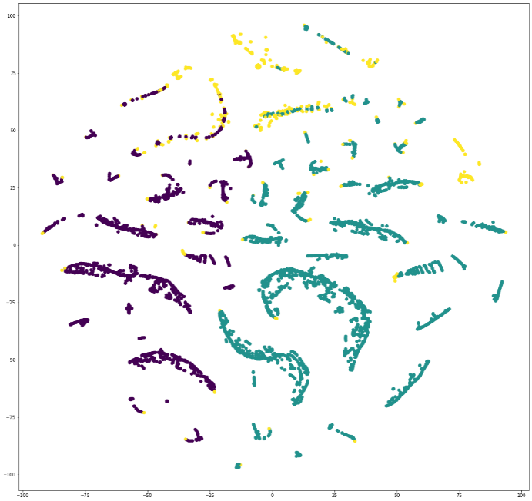
Gaussian Mixture Clustering Graph
Figure 5: Gaussian Mixture Clustering Graph

Slide 12
K-Means Clustering 2 Clusters
Feature that influenced separation of clusters the most was Vulnerability Score
One cluster has Vulnerability Score average around 0.1
Another cluster has Vulnerability Score average around 0.5

Slide 13
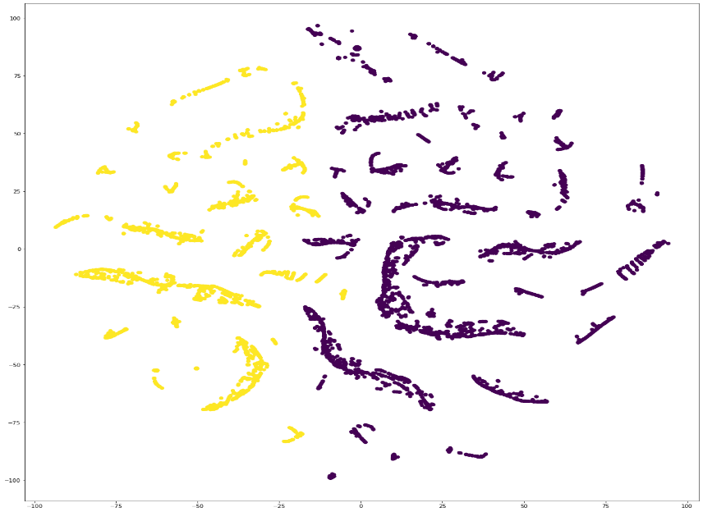
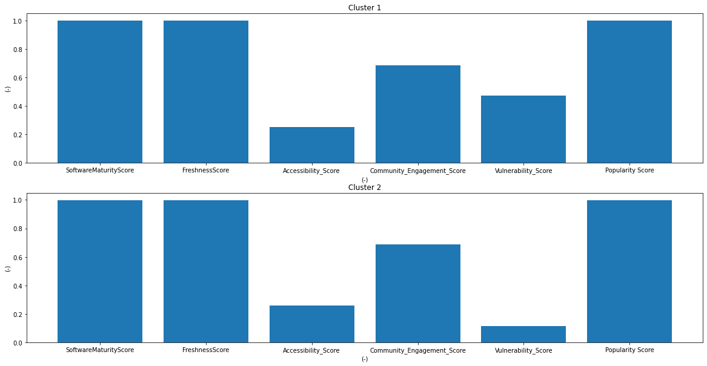
K-Means Clustering Graph
Figure 3: K-Means Clustering graph with 2 clusters, 6 features and random state of 59
Figure 4: K-Means Clustering Histograms

Slide 14
K-Means Risk Scores
Developed using each package’s distance to its cluster’s centre
The higher the distance to its cluster’s centre, the higher the risk score
General distribution shows most packages have risk score of 5% to 17%
This distribution makes sense when thinking in a broad perspective
Most packages in the real world will have low risk scores since they are benign

Slide 15
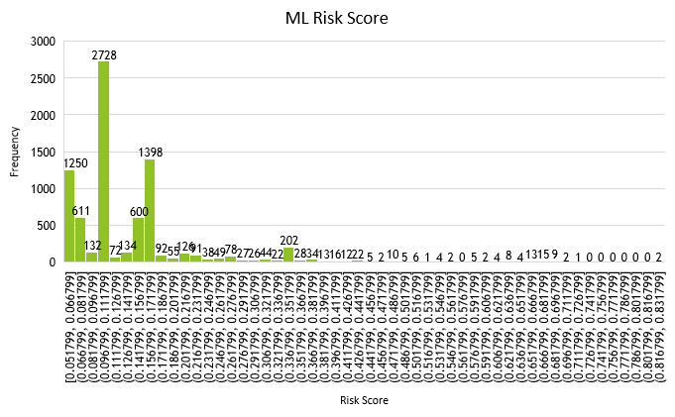
K-Means Risk Scores
Figure 6: Histogram of Risk Scores for 8000 packages

Slide 16
K-Means Reliability Scores
Developed using 1 – risk score
The lower the distance to its cluster’s centre, the higher the reliability score
General distribution shows most packages have reliability score of 82% to 95%
This distribution makes sense when thinking in a broad perspective
Most packages in the real world will have high reliability scores since they are benign

Slide 17
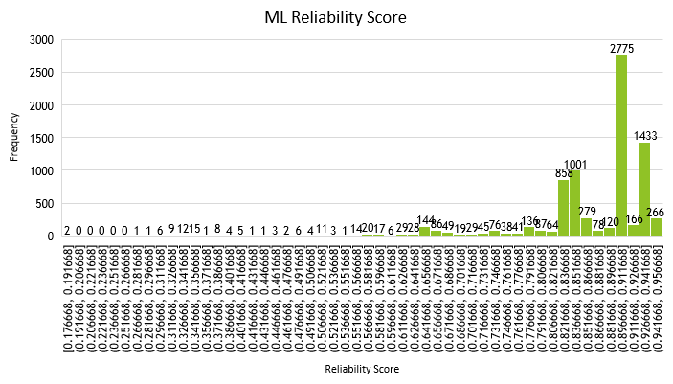
K-Means Reliability Scores
Figure 7: Histogram of Reliability Scores for 8000 packages

Slide 18
Problem found with scores
The distance from one package to its cluster is not the same risk as another cluster
One cluster may have an overall higher Vulnerability Score hence, increasing risk
Risk Scores will need to be manually weighted based on characteristics of cluster
Weighted score only applied to cluster 1 as cluster 1 has 5 times higher Vulnerability Score

Slide 19
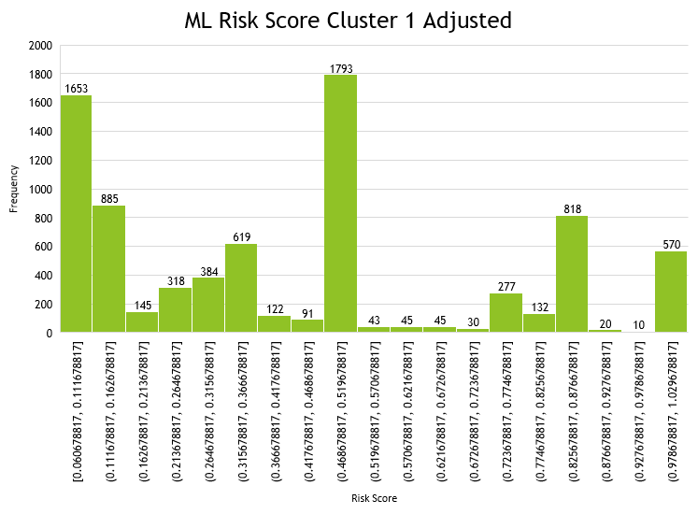
K-Means Weighted Risk Scores
Figure 8: Histogram of Weighted Risk Scores for 8000 packages

Slide 20
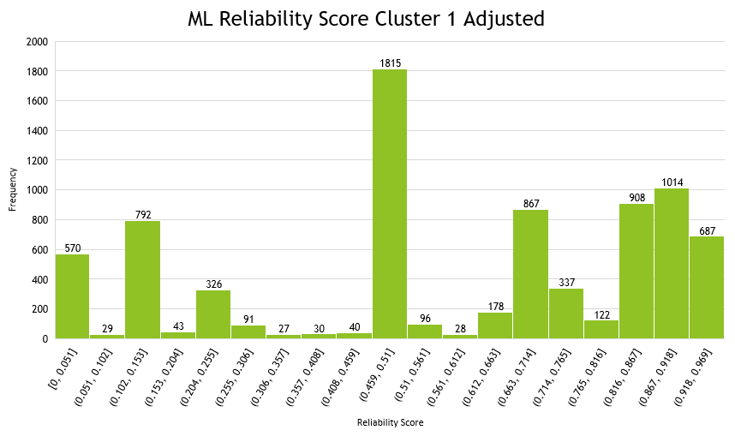
K-Means Weighted Reliability Scores
Figure 9: Histogram of Weighted Reliability Scores for 8000 packages

Slide 21
Validation Risk Scores
Have more packages with higher risk score from 70% to 85%
Distribution is different to K-Means approach due to different way of calculating overall risk

Slide 22
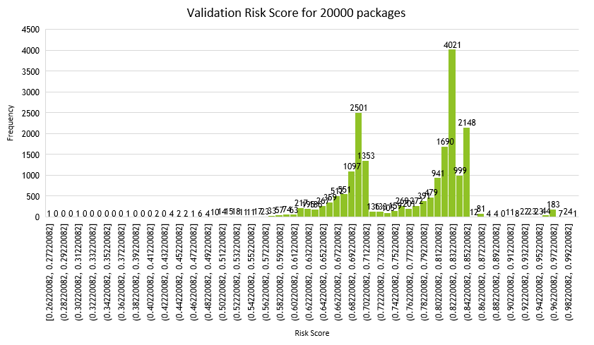
Validation Risk Scores
Figure 10: Histogram of Validation Risk Scores for 20000 packages

Slide 23
Validation Reliability Scores
Have more packages with lower reliability score from 16% to 33%
Distribution is different to K-Means approach due to different way of calculating overall reliability

Slide 24
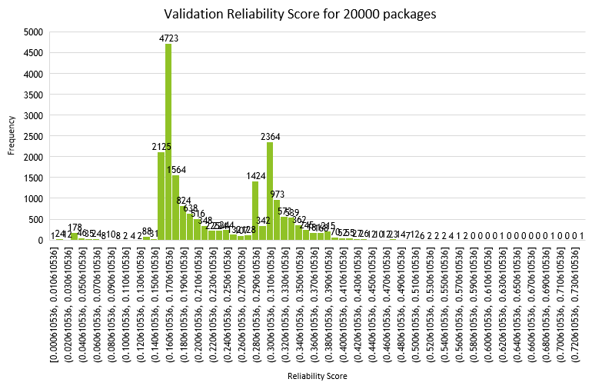
Validation Reliability Scores
Figure 11: Histogram of Validation Reliability Scores for 20000 packages

Slide 25
Areas for improvement
Overall data distribution for risk and reliability scores
Increasing number of data points used in models
Trying different clustering algorithms

Slide 26
Conclusion
Project is a success due to ML model generating risk assessment
Research gap of using unsupervised machine learning has been achieved
Data distribution of packages risk and reliability scores can be improved with more data
Other types of clustering should be tested

